Slide 1
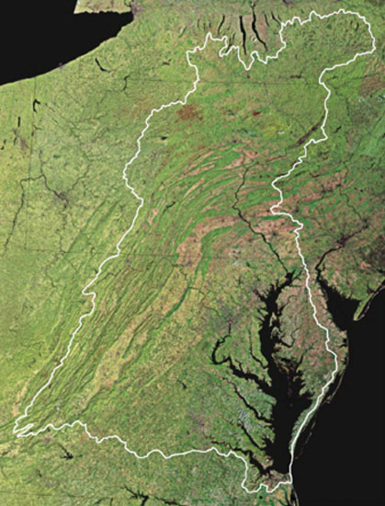
It’s The Final Countdown To The Mid-point Assessment:
What is it?
and
Why should you care?
Choose Clean Water Coalition Conference
May 24, 2017
Rich Batiuk, Associate Director for Science, Analysis and Implementation
Chesapeake Bay Program Office
U.S. Environmental Protection Agency
Annapolis, Maryland

Slide 2
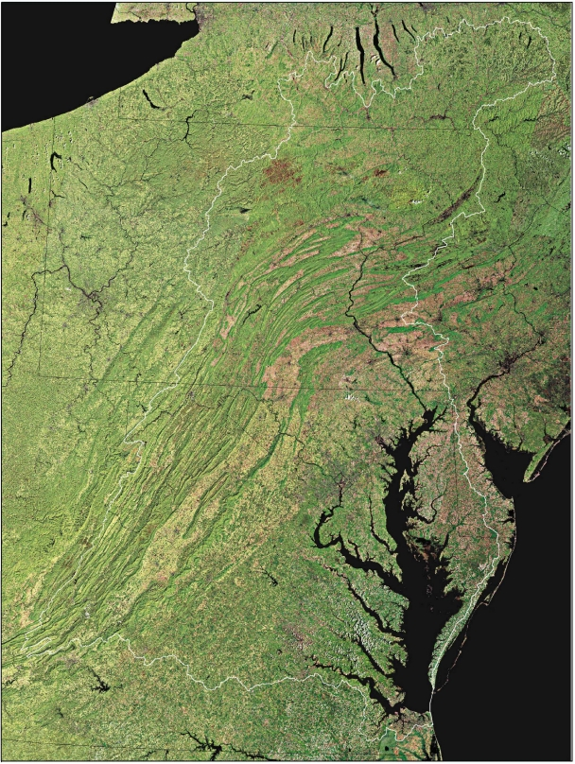

Slide 3
THE BAY AND THE WATERSHED ARE RESPONDING TO 30+ YEARS OF OUR INDIVIDUAL AND COLLECTIVE ACTIONS

Slide 4
ACTIONS BY THOUSANDS OF FARMERS, MUNICIPALITIES, HOMEOWNERS ARE MAKING A DIFFERENCE

Slide 5
Chesapeake Bay Watershed Municipal and Industrial Wastewater Treatment Facilities Discharged Nitrogen Loads: 1985-2015
Notes:
In 2015, the Partnership achieved its 2025 nitrogen and phosphorus loading reduction goals for the wastewater sector—10 years early!
The six states and the District have reduced nitrogen discharges from over 470 municipal and industrial wastewater treatment facilities by over 40 million pounds delivered to Bay tidal watershed since 1985.
Now, over 70 facilities across the watershed are routinely discharging below 3 mg/L total nitrogen, a value previously considered as the limit of engineer technology!

Slide 6
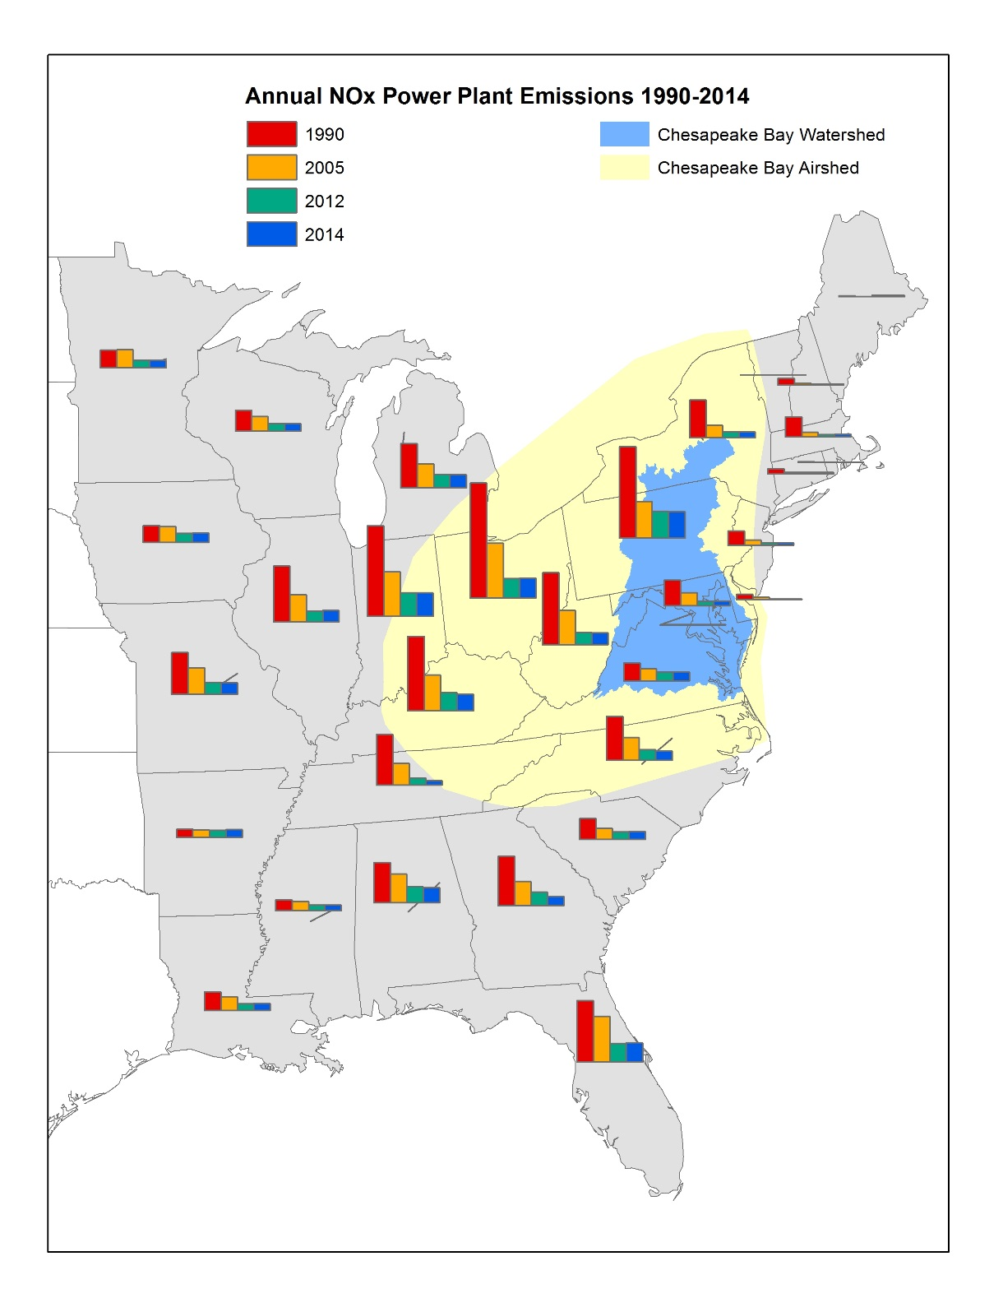
35 million lbs. reduction to Bay: 1985-2015
http://gis.chesapeakebay.net/air
Notes:
Airshed is 570,000 square miles – 9 times larger than the watershed
1/3 of nitrogen pollution comes from air deposition
Between 1985-2015, loads of oxidized nitrogen from atmospheric deposition in the Chesapeake Bay watershed is projected to decrease by about 60%

Slide 7
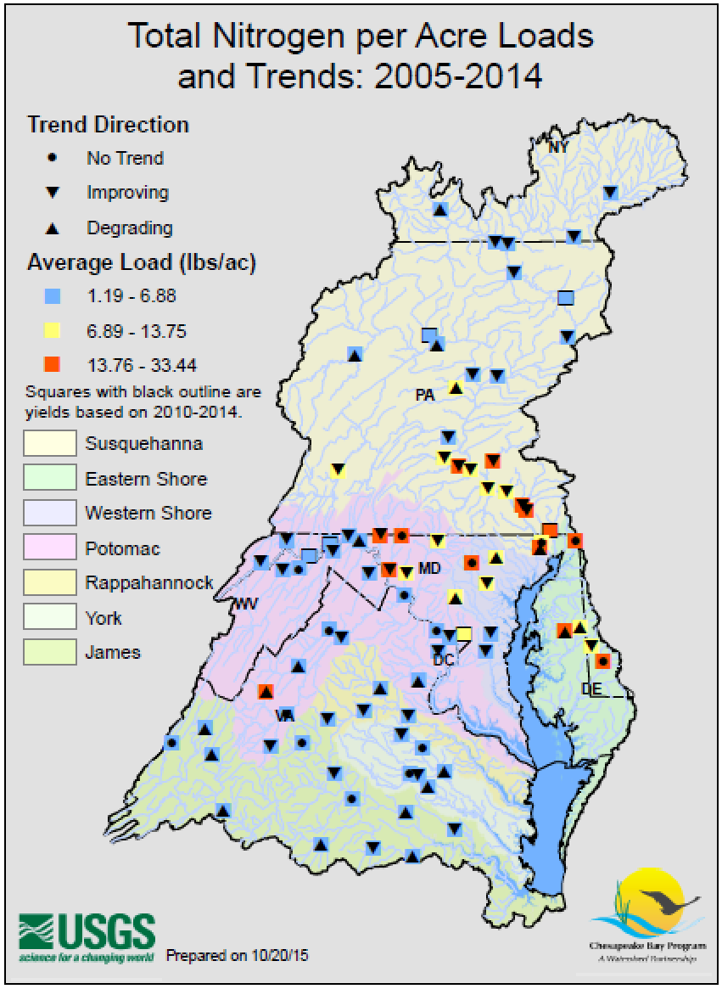
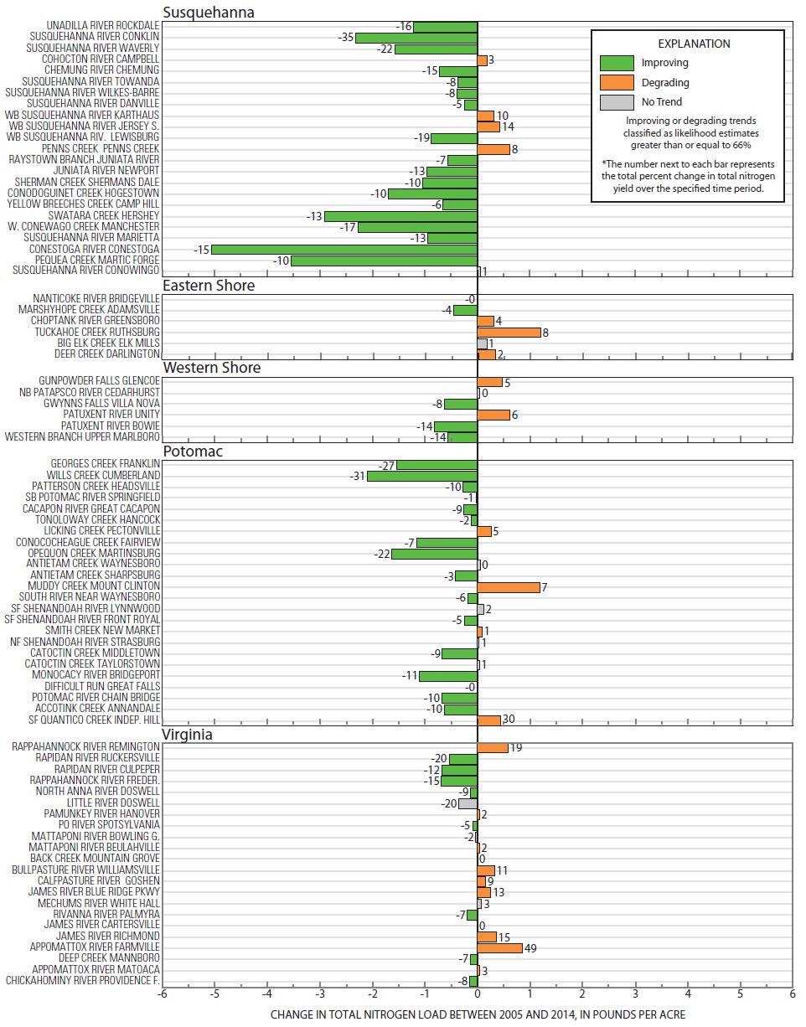

Slide 8
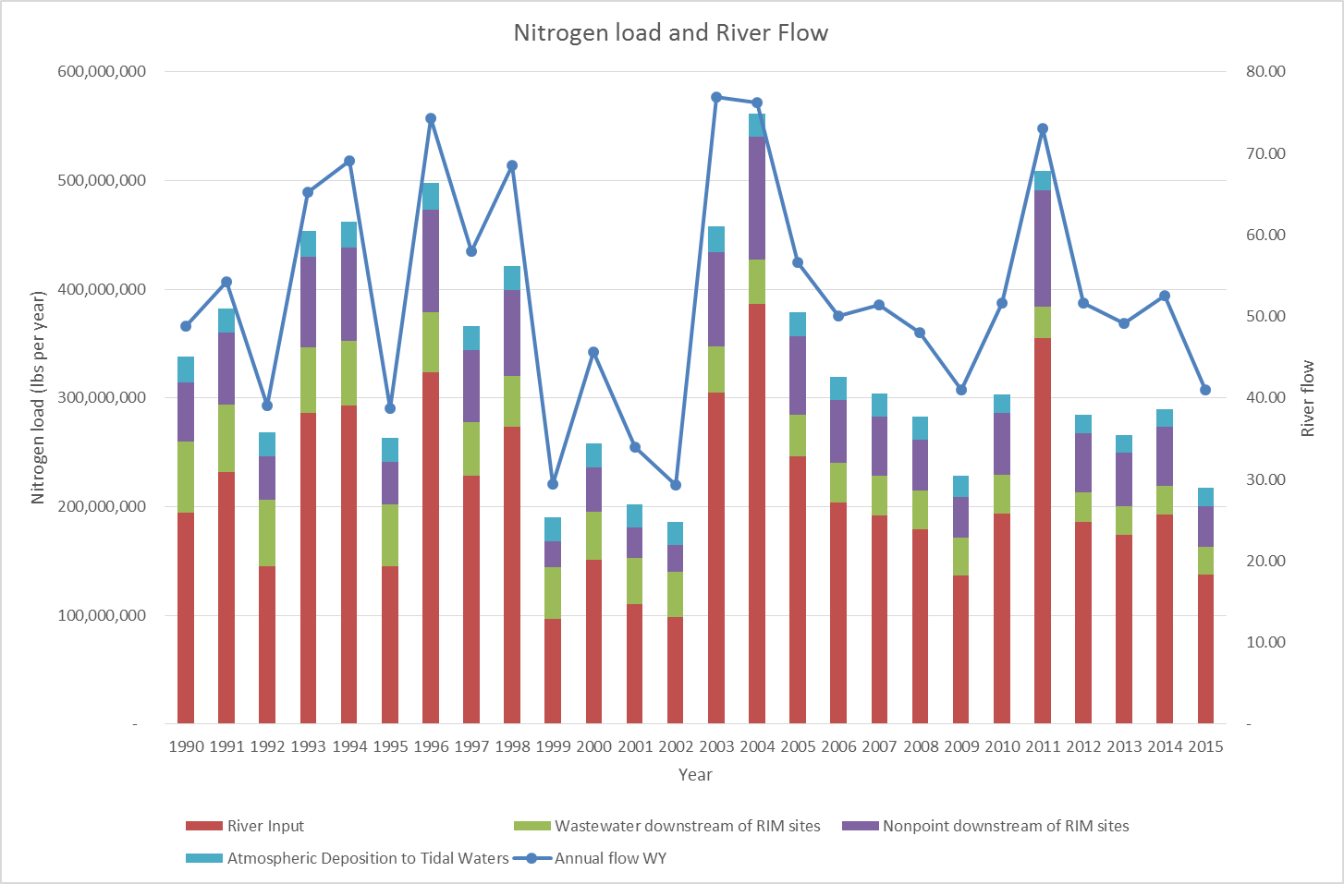

Slide 9
The Bay ‘s Summertime Dead Zone is Decreasing in Size!
Source: Testa, 2017 unpublished

Slide 10
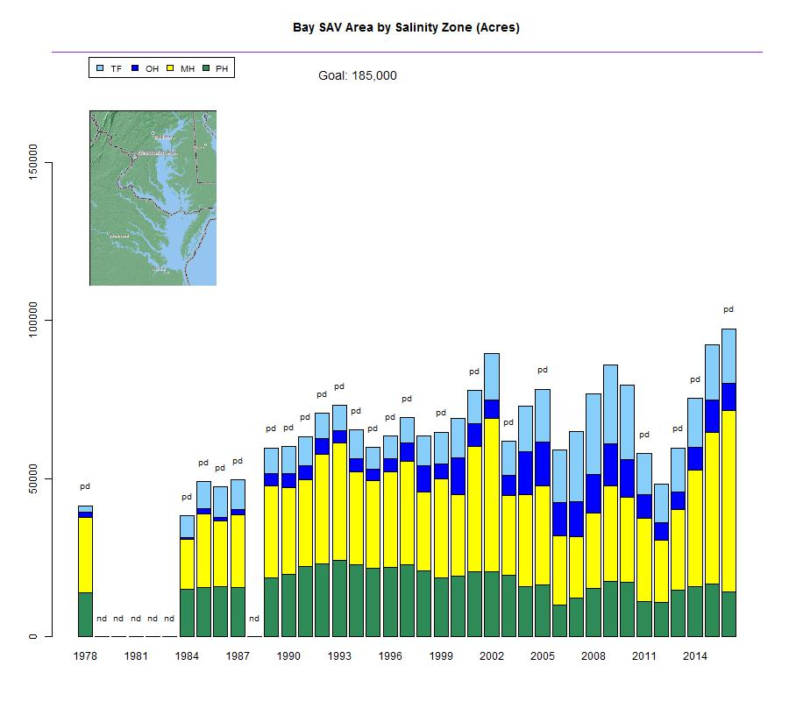
Chesapeake Bay SAV Trends: 1978-2016
Almost 100,000 acres!

Slide 11
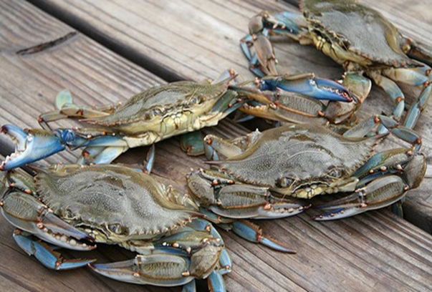
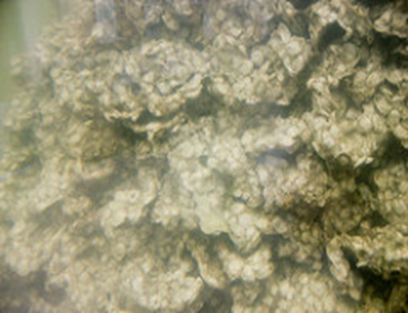
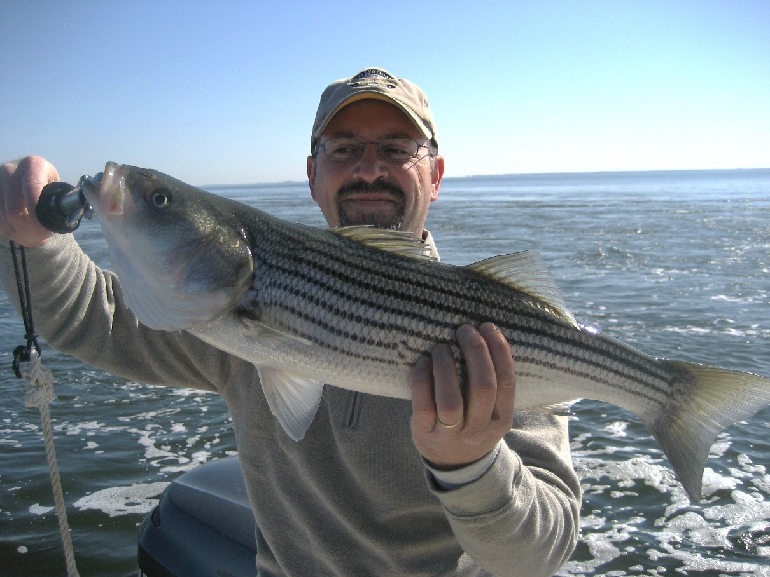
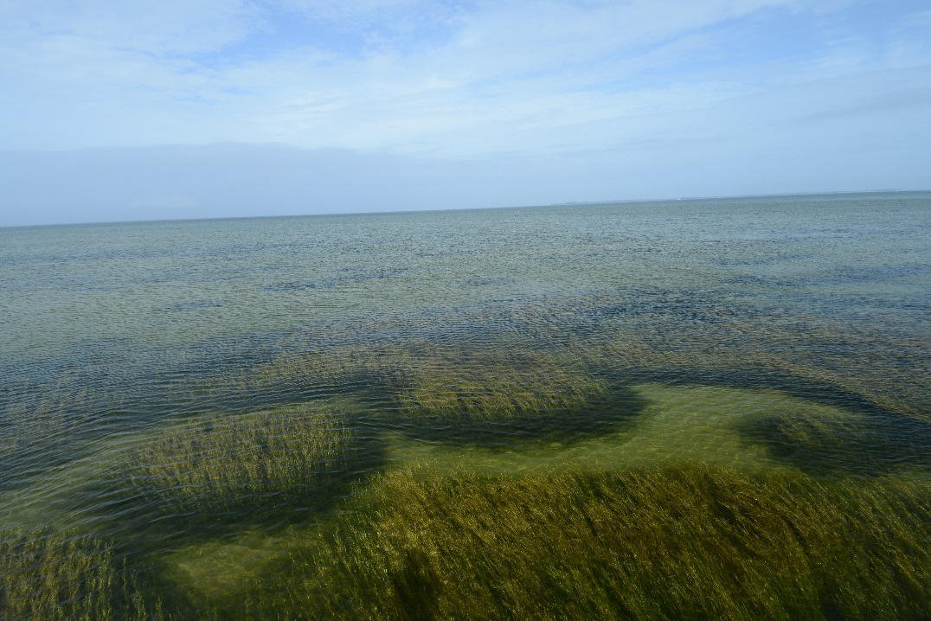

Slide 12
Chesapeake Bay Watershed Nitrogen Loads: 1985-2015
318
242
2015
1985
59% Wastewater
39% Agriculture
2% Forest
Where did the nitrogen reductions come from?

Slide 13
Chesapeake Bay Watershed Nitrogen Reductions: 2015-2025
242
192
2025
2015
Where will the remaining nitrogen reductions* come from?
71% Agriculture
24% Urban Stormwater
5% Septic Systems
*Based on the jurisdictions’ Phase II WIPs.

Slide 14
Nitrogen Load to be Reduced by 2025

Slide 15
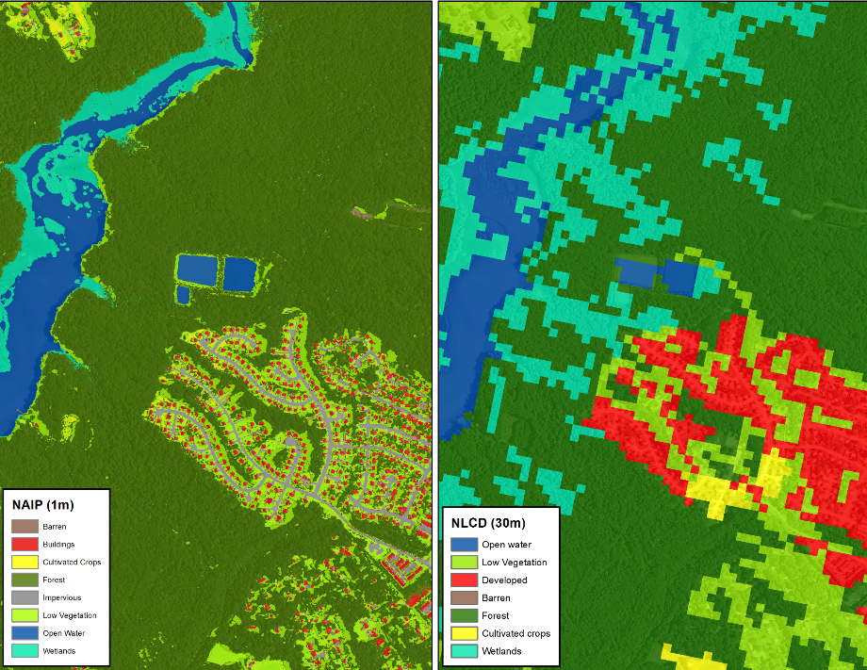
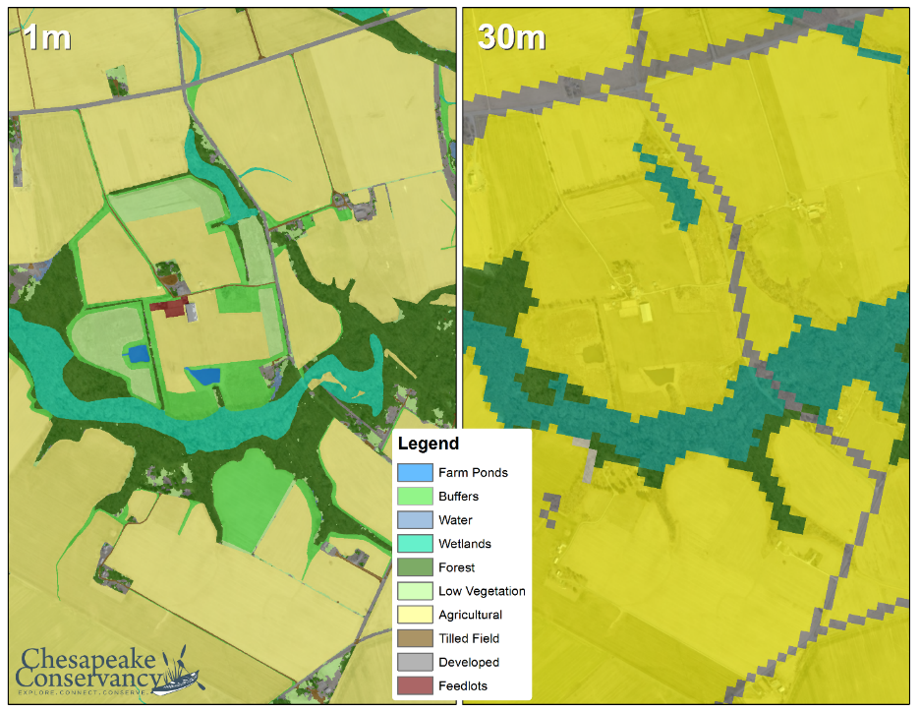
Chesapeake Bay Watershed Land Cover Data
Phase 5
Phase 6
Urban/Suburban Settings
Rural Settings

Slide 16
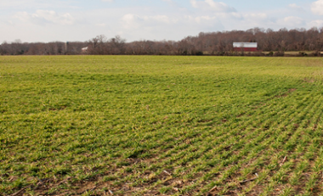
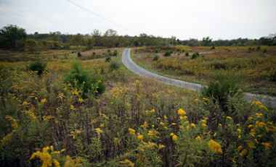
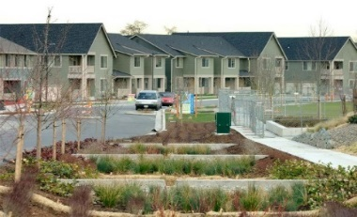
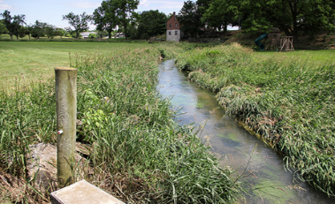
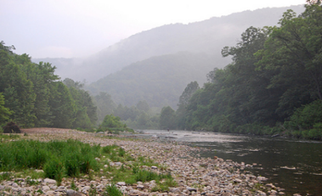
Phase 6 Watershed Model Structure
Average Load + Inputs * Sensitivity
Land Use Acres
BMPs
Land to Water
Stream Delivery
River Delivery
*
*
*
Direct Loads
*
*

Slide 17
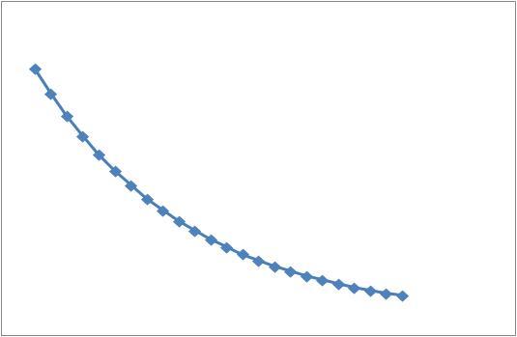

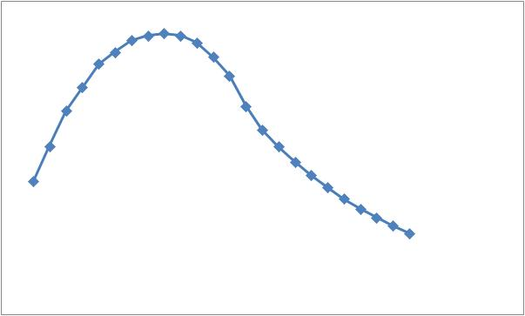
Each Loading Event
Surface
Nutrient
Submodels
HSPF
Time =>
Concentration=>
Sum=
Subsurface

Slide 18
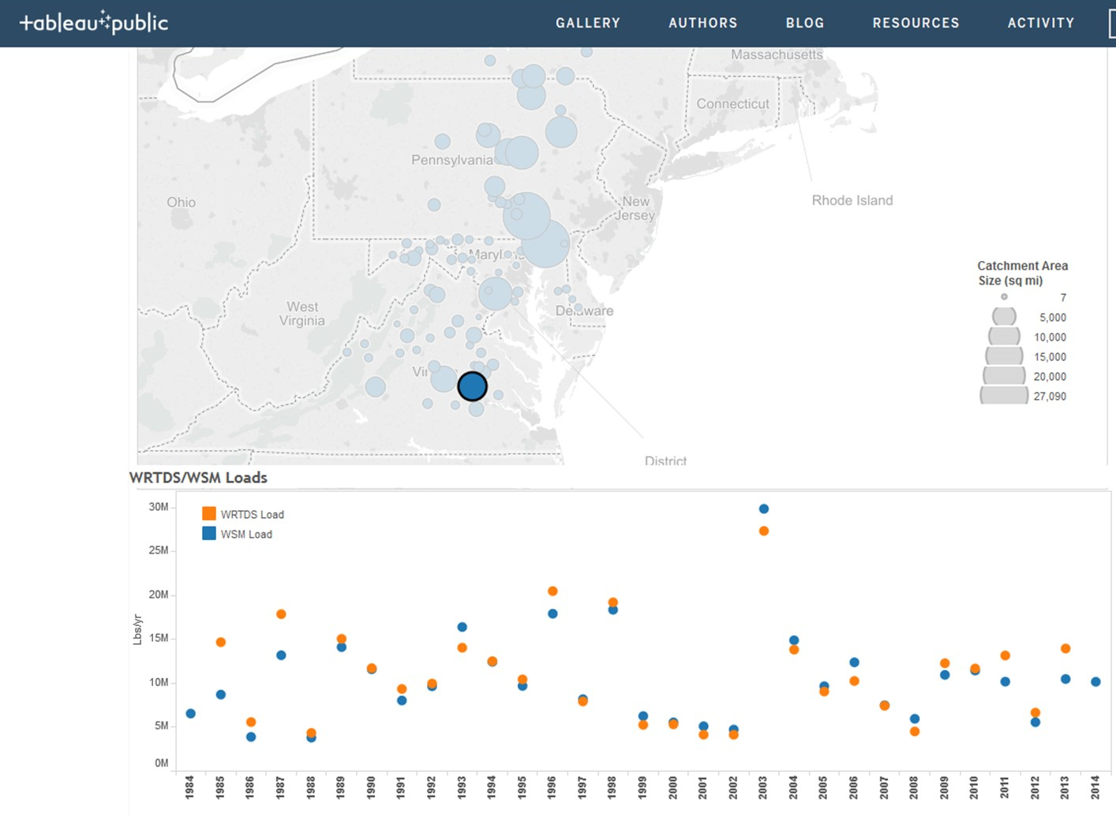
Monitored
Modeled

Slide 19
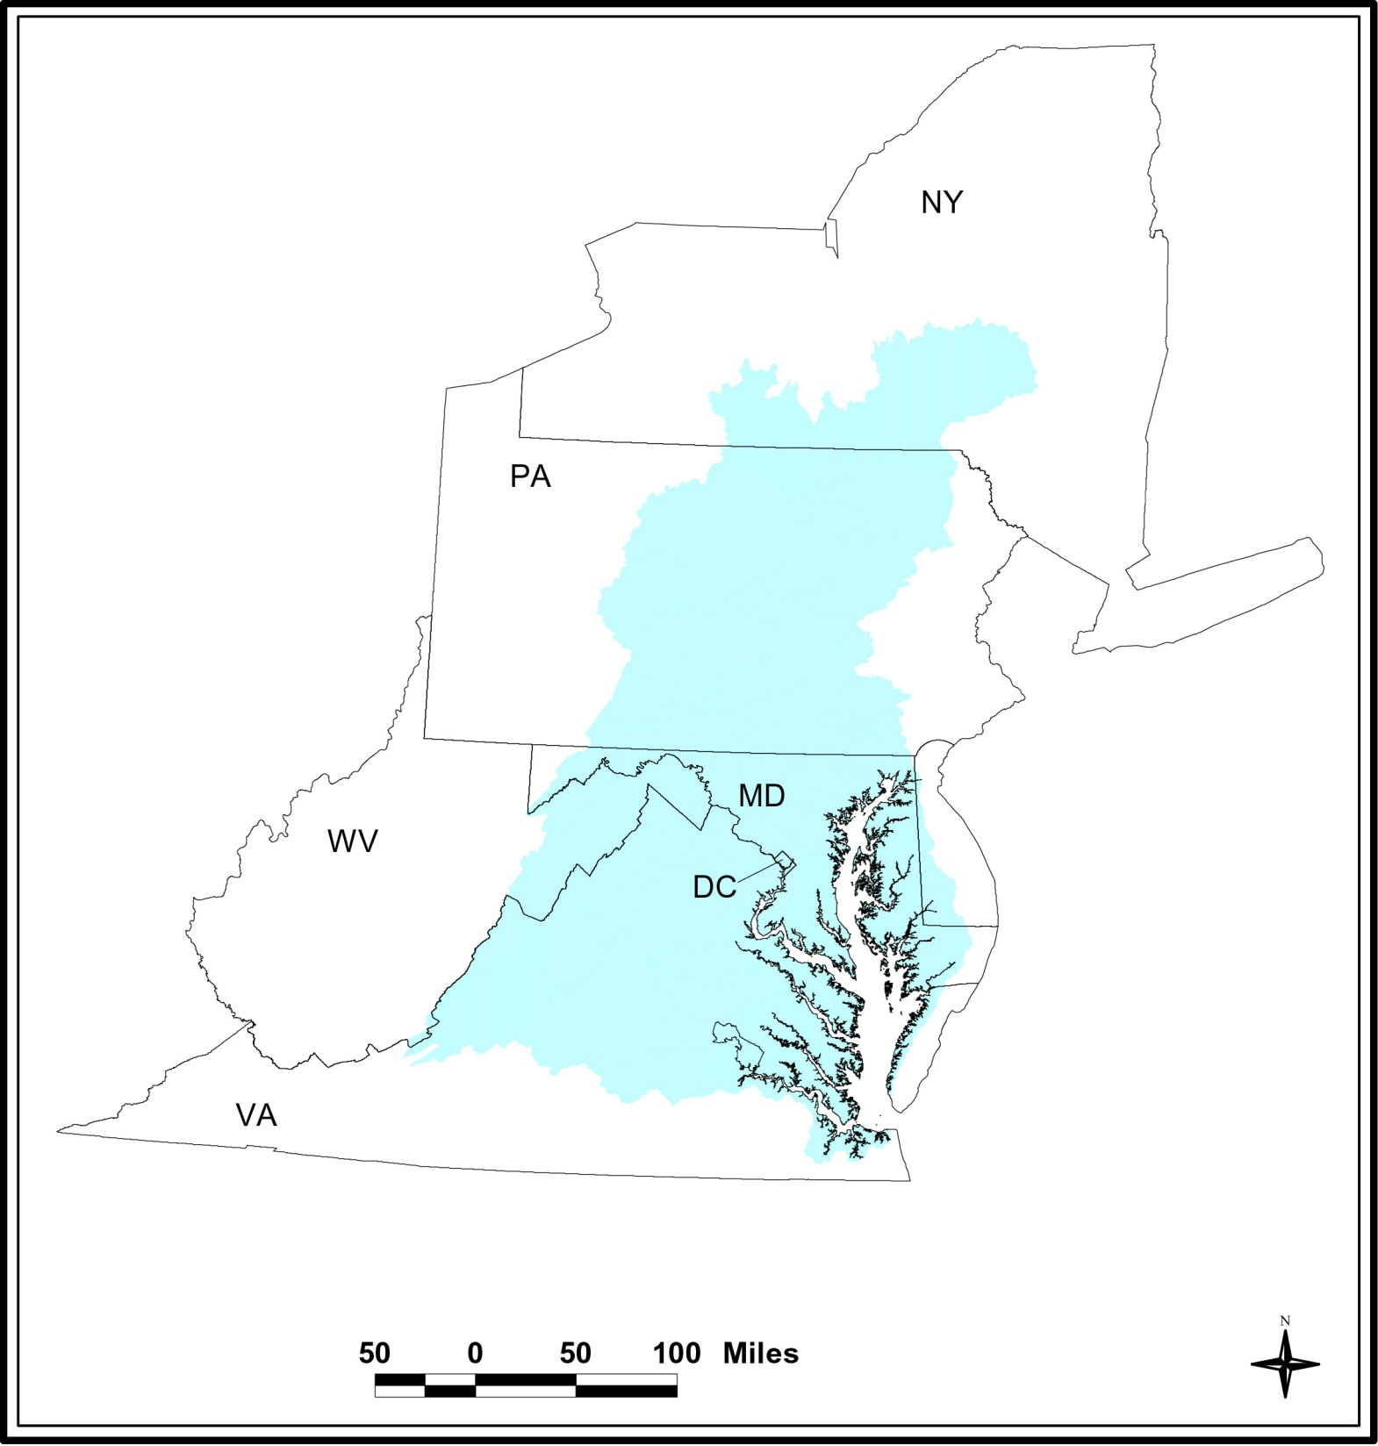
Midpoint Assessment
Challenges and Opportunities by State
DE

Slide 20
New York
Challenges
Further reductions from wastewater
Consistent source of ag cost share $
Opportunity targeted
Pounds reduced to get to one less pound delivered to the Bay
Opportunities
Upper Susquehanna Coalition
Innovative approaches, practices and delivery
Significant improving trends in local streams and rivers
DE

Slide 21
Pennsylvania
Challenges
34 million pound nitrogen deficit
Unachievable stormwater goals
Over 90% needs to come from ag
No dedicated state ag cost share $
Lacking programmatic capacity
Need more boots on the ground
Minimal enforcement of existing laws; level of compliance not known
Opportunities
Improving trends across most rivers
Solid state regulations
Shared vision from “PA in the Balance” conference
Ag, natural resources critical to local and state economies
DE

Slide 22
West Virginia
Challenges
Possible cuts in federal cost share
No dedicated state ag cost share program
Opportunities
Motivated to demonstrate voluntary approach can work
Wastewater goals achieved ahead of schedule
Significant improving trends in local streams and rivers
Possible nitrogen for phosphorus exchanges
DE

Slide 23
Maryland
Challenges
Achieving stormwater goals by 2025
Phosphorus saturated soils, groundwater lags on Eastern Shore
Must achieve WQ standards in each of 54 Bay segments
Opportunities
Significant improving Bay WQ trends
Excess capacity in wastewater sector
Solid financing programs in place and working
Engaged local county, municipal partners
DE

Slide 24
District of Columbia
Challenges
Opportunities
Achieved 2025 nitrogen, phosphorus goals
All sources are regulated
Solid financing, regulatory infrastructure in place
DE

Slide 25
Delaware
Challenges
Phosphorus saturated soils, groundwater lags on Eastern Shore
Not on ag practice implementation trajectory to achieve nitrogen 2025 goals
Opportunities
Signs of improving trends
Strong state watershed assessment/ planning system in place
Engaged local counties, municipal partners
DE

Slide 26
Virginia
Challenges
Achieving stormwater goals by 2025
Fluctuating state ag cost share program funding levels
Must achieve WQ standards in each of 38 Bay segments
Opportunities
Significant improving Bay WQ trends
Excess capacity in wastewater sector
Solid state regulations, laws in place
Trading, offset infrastructure in place and being used
DE

Slide 27
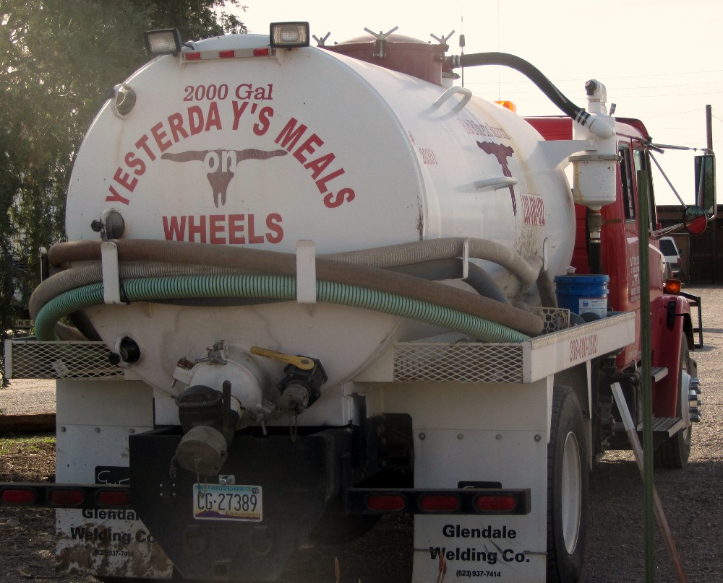

Slide 28

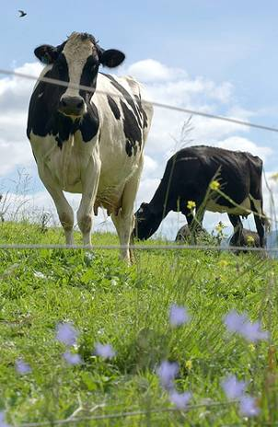

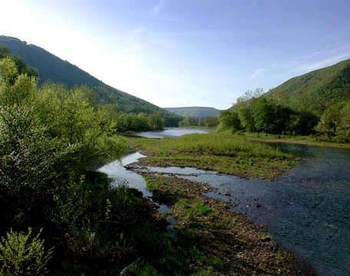
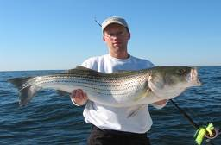
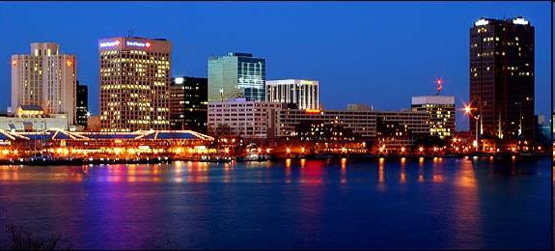


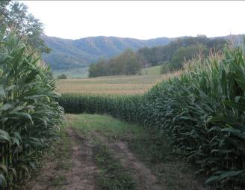
Questions
28

Slide 29

Rich Batiuk
Associate Director for Science, Analysis
and Implementation
U.S. EPA Chesapeake Bay Program Office
410-267-5731 Work
443-223-7823 Mobile
batiuk.richard@epa.gov
www.chesapeakebay.net

