Slide 1
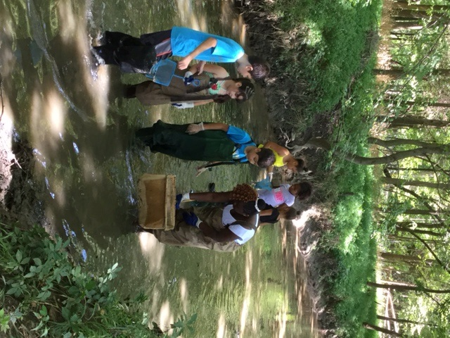
Communities for Clean Streams:
Growing a Partnership to Address Environmental Issues
Monica Billger
Virginia Conservation Advocate

Slide 2
“Individually, we are one drop. Together, we are an ocean.”
— Ryunosuke Satoro
GETTING STARTED: Opportunities & Barriers
Mission
Capacity – ID Tools
Partners – Research Community
Relationships
Engagement

Slide 3
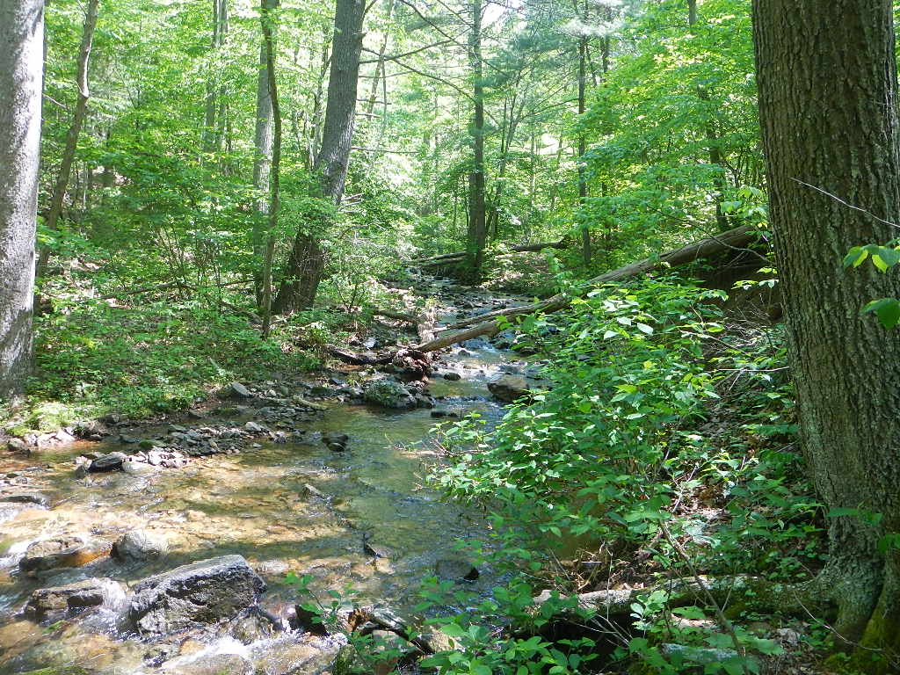
#1 Mission
Cleaner Streams
in every Neighborhood
Connecting People to their Natural environment & local stream
Educating residents & community leaders about the link between water quality, urban development and healthy communities
Influencing local clean water policies and inspires individual best practices to produce cleaner streams in the region.
Notes:
Reaching 5,000 kids with hands-on environmental education

Slide 4
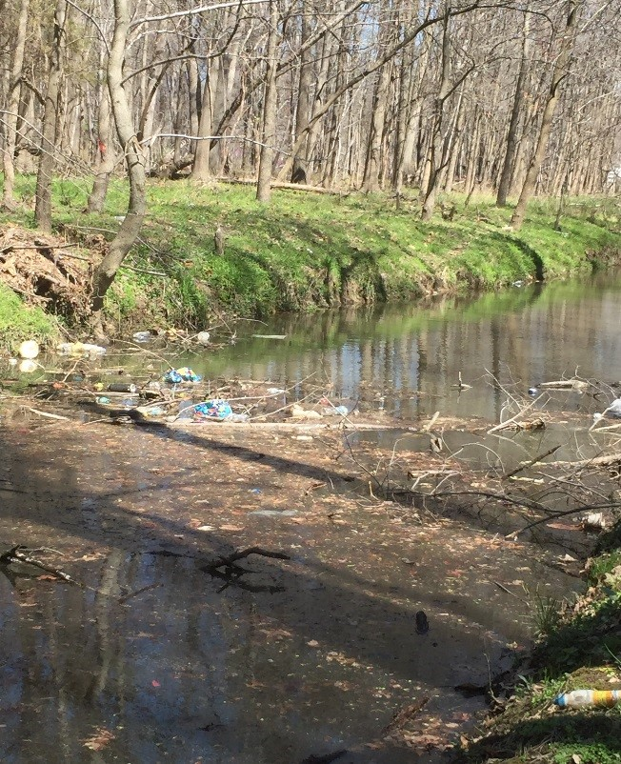
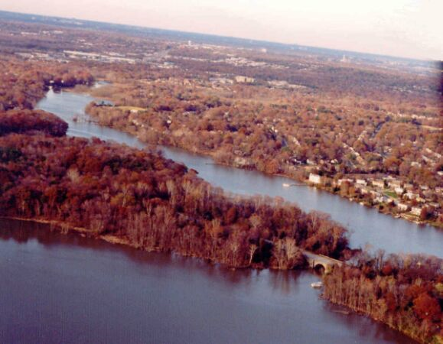
Little Hunting Creek (3.1 mile tidal tributary of the Potomac) is one of the most severely degraded streams in Fairfax County. In 2007, it was named “Fairfax County’s Trashiest Stream”
Over the last seven years volunteers have removed:
186+ shopping carts
450+ bags of trash
50+ tires
over a dozen bikes
multiples car seats, a .22 caliber-hunting rifle., a bathtub, and a bounce house (among other items)
Notes:
Mount Vernon Patch - http://patch.com/virginia/mountvernon/s/fowdm/2016-little-hunting-creak-cleanup-Saturday
Fairfax County DPWES, Fairfax County Department of Health

Slide 5
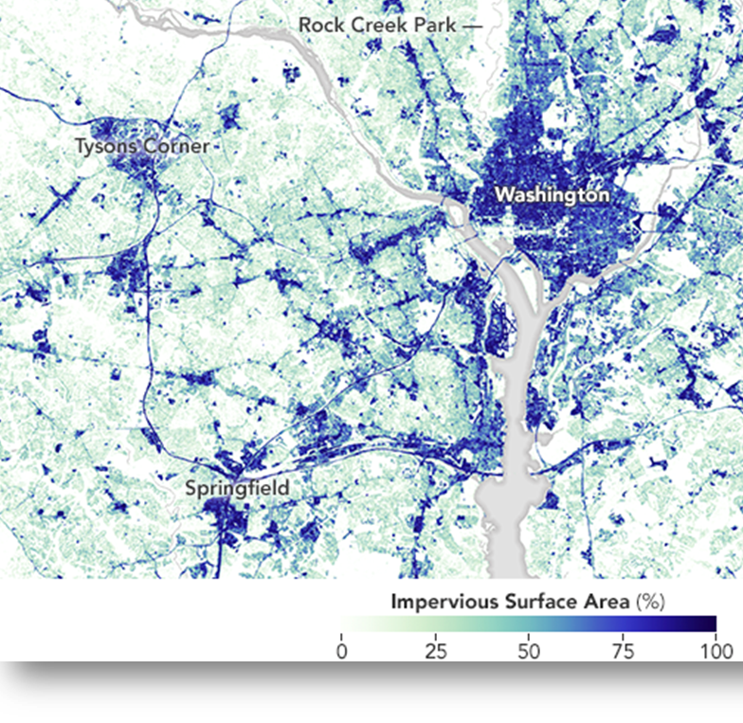
Impervious (Paved) Surface 1984
IMPERVIOUS (PAVED) SURFACE 2010
NASA

Slide 6
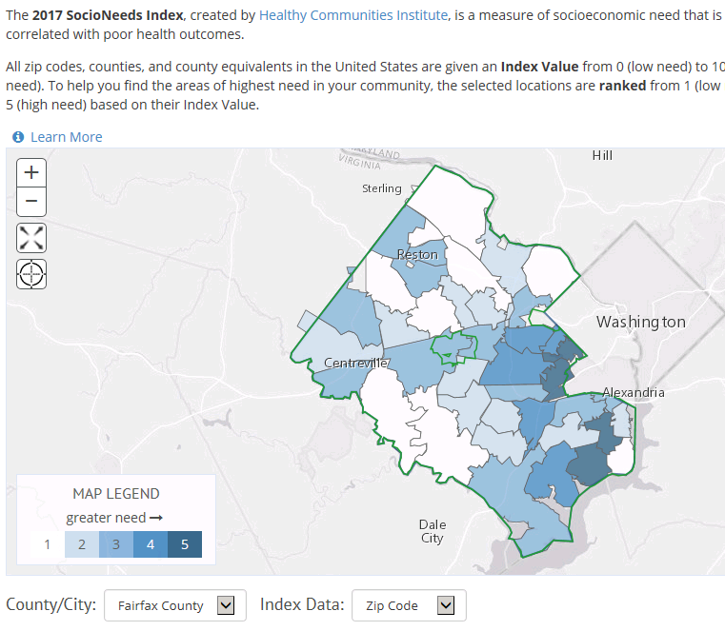
Notes:
Live Healthy Fairfax is a Community Health Dashboard for Fairfax County and the cities of Fairfax and Falls Church. web-based data resource for the Fairfax community. This site enables anybody to explore existing population data. The Community Health Dashboard provides online access to data on a broad range of topics, links to existing local data resources, and highlights promising practices to promote community health and well-being.
http://www.livehealthyfairfax.org/
http://www.policylink.org/
http://nationalequityatlas.org/
National Equity Atlas released in 2014. first-of-its-kind web resource for the data and tools community leaders and policymakers need to track, measure, and advance the policies to achieve inclusive growth in America’s regions, states, and nationwide. The Atlas was expanded to share data for the 100 largest cities in October 2015.
Virginia Commonwealth University Center on Society and Health & Northern VA Health Foundation Report
A Study in Contrasts: Why Life Expectancy Varies In Northern Virginia
What explains the large inconsistencies in health across Northern Virginia?Why are babies born in some neighborhoods—
separated by only two or three miles—facing shorter lifespans than newborns in other areas? Five factors that matter most are: health care, individual behaviors, socioeconomic circumstances, the environment, and public policies and spending.
Fairfax County’s GDP would have been $26.2 billion higher in 2012 if its racial gaps in income were closed.
Healthy Communities Institute compiled 2017 SocioNeeds index – Highest value have highest needs that correlate with preventable hospitalizations and premature death.

Slide 7
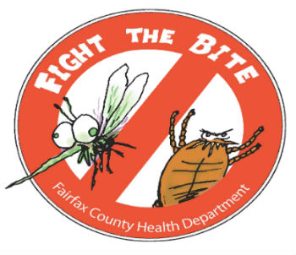
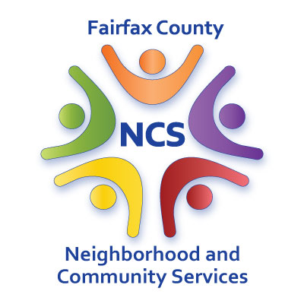
#3 Partners
Good Shepherd Catholic Church

Slide 8
#4 RELATIONSHIPS
LISTEN
CONNECT
ACT
SUSTAIN
LEARN
Trust
Notes:
Learn about the community & local issues. Listen to priorities, concerns, accomplishments, barriers. Connect your mission with what you have heard and learned. Act by developing an engaging educational/outreach opportunity led by the ideas of the community. Sustain the relationship through continued community communication and expansion of community network and partners.

Slide 9
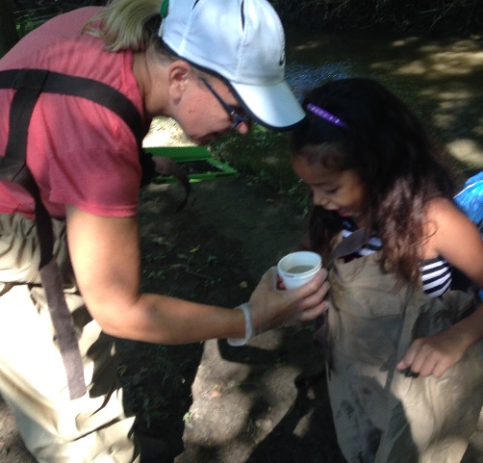
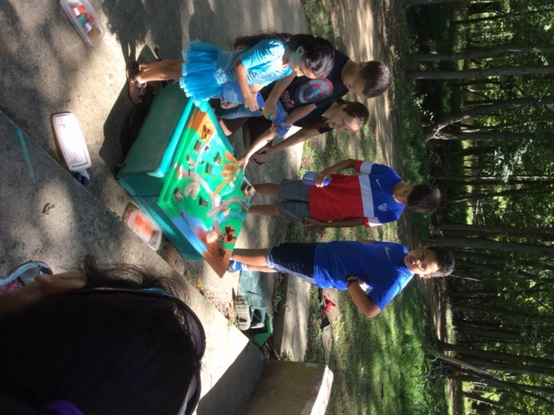
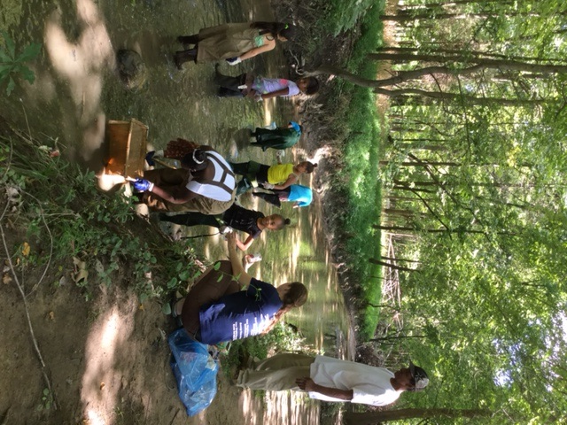
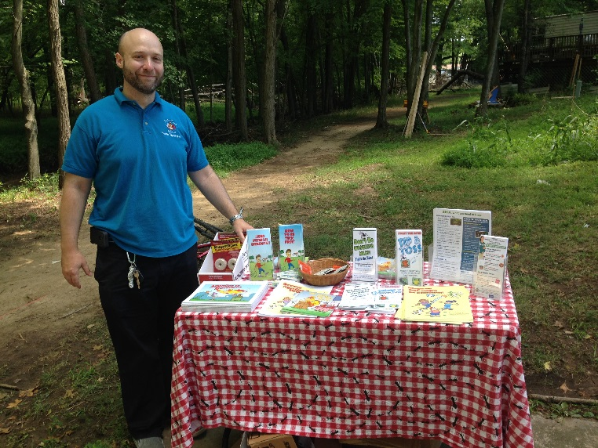
#5 ENGAGEMENT
Notes:
Enlist the community to prepare the flier/communication

Slide 10
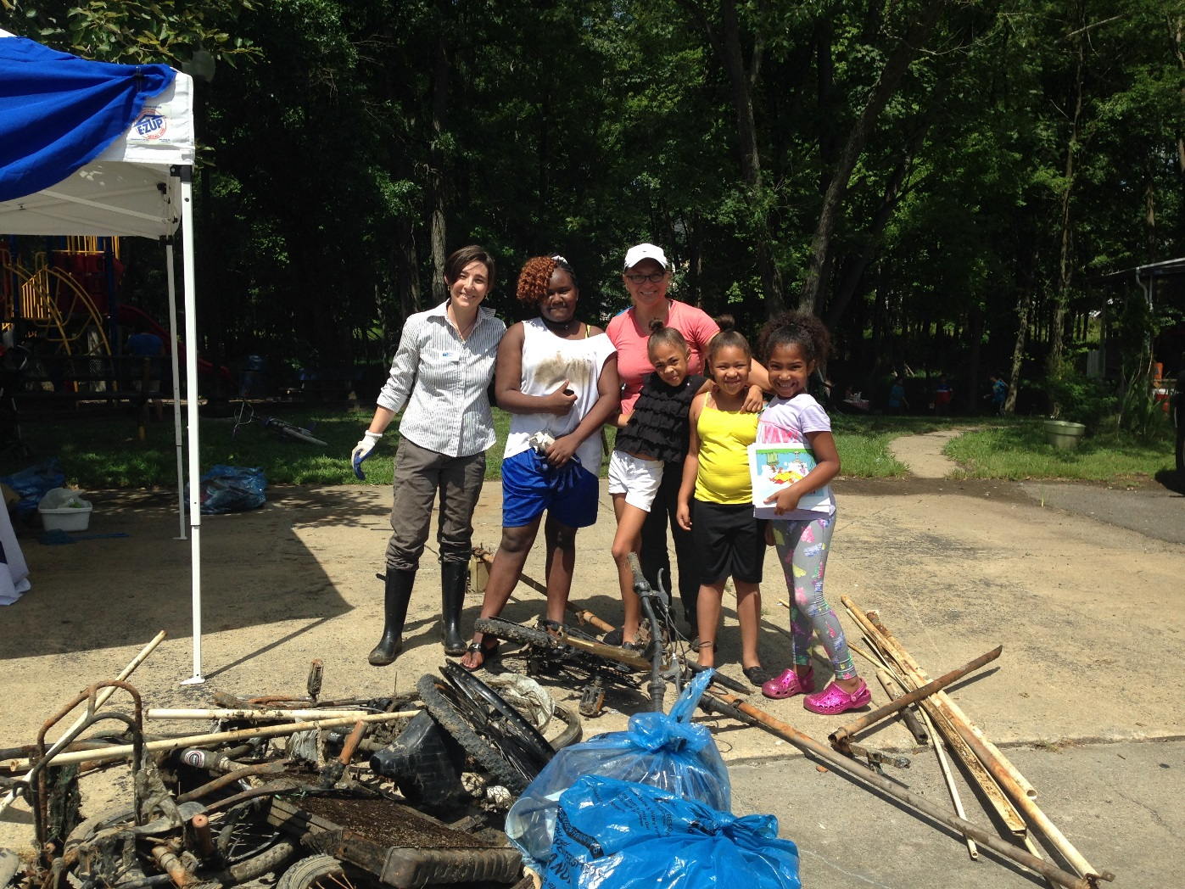
Monica Billger
Virginia Conservation Advocate, ANS
Monica.billger@anshome.org
571-278-5535
http://anshome.org/
Securing a bright future for people and the environment –
TOGETHER!

