Slide 1
Tools for EJ: Authentic Community Engagement
Clean Water Heroes in the Faith Community
Anna Awimbo, Program Manager
Interfaith Partners for the Chesapeake

Slide 2
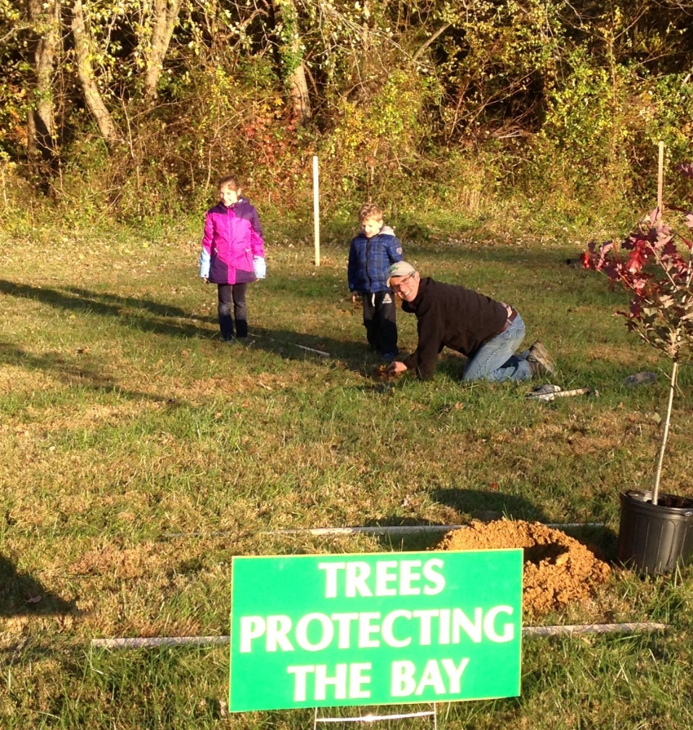
Interfaith Partners for the Chesapeake
Interfaith Partners for the Chesapeake (IPC) aims to educate, support and inspire people and communities of faith to advocate for the waters of the Chesapeake through policies and practices that promote a healthier environment and healthier people.
IPC’s motto: Forming Faithful Stewards, Caring for Sacred Waters

Slide 3
Faith Teachings on Care for the Environment
Christian - connect water with baptism and stewardship; broaden “love thy neighbor” to natural world
Jewish - Tikkun Olam, repair and restoration of the whole world. Mikvah – a ritual bath
Muslim - unique role and responsibility of the human to be guardians of God’s Creation. Ablution – preparing for prayer
Buddhist – interconnectedness of all life, compassion for the suffering of the natural and human world
Sikh - Air is the Teacher, Water is the Father and Earth is the Great Divine Mother of All and we must respect and protect her ~Guru Nanak

Slide 4
Three Main Programs
Trees for Sacred Places
Vacation Bible School training and technical support.
One Water Partnership

Slide 5
Trees for Sacred Places Program
A partnership with IPC and the Alliance for the Chesapeake Bay
2013-2015 Planted over 10,000 trees at over 40 locations (funded by the MD Dept. of Natural Resources)
2016-2017 funded by the Chesapeake Bay Trust
Engagement of faith communities in care for creation through planting trees… and as a stepping stone to more faith-filled action!

Slide 6
Imagine the Potential…
Start the Ripple Effect!
Maryland : 5,336 congregations
*Data from the Association of Religion Data Archives http://www.thearda.com/rcms2010/

Slide 7
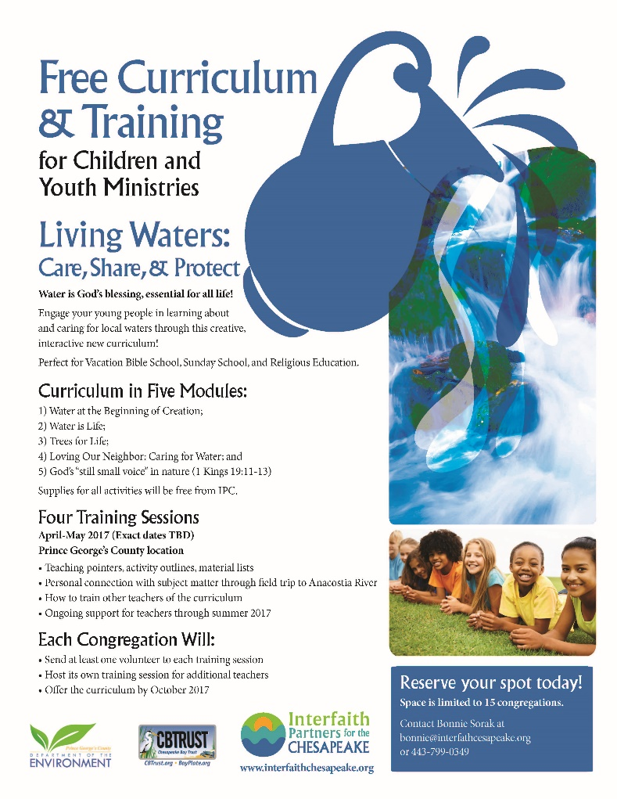
Vacation Bible School Training
Congregation leaders attend 4 education sessions and receive training on good stormwater management practices.
VBS offered each summer for congregation youth

Slide 8
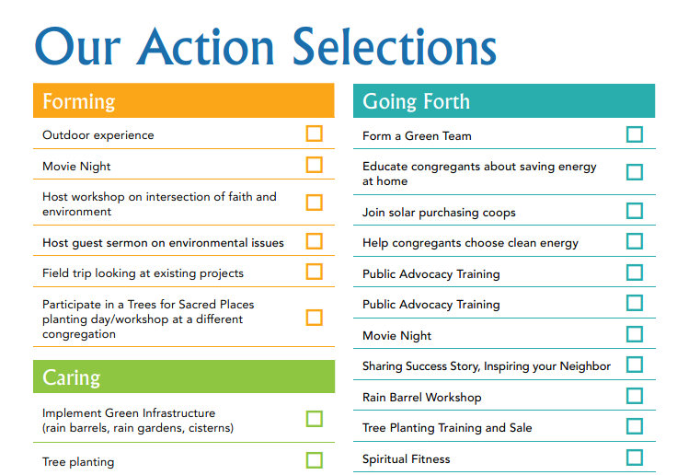
One Water Partnership
No one-size-fits-all
Surround congregations with partners – “personal trainers”
Teach people to love and cherish their own sub-watershed
Connect people to others in their sub-watershed community

Slide 9
How to Partner with IPC
IPC as a Recruiter
Hire IPC to help you recruit congregations for your programs
Co-conceptualize programs where IPC’s role is funded
Help us with GIS capabilities to know where large church properties are
IPC as an Educator
Partner with IPC to bring the faith-based message to your audience
get around church/state separation this way

Slide 10
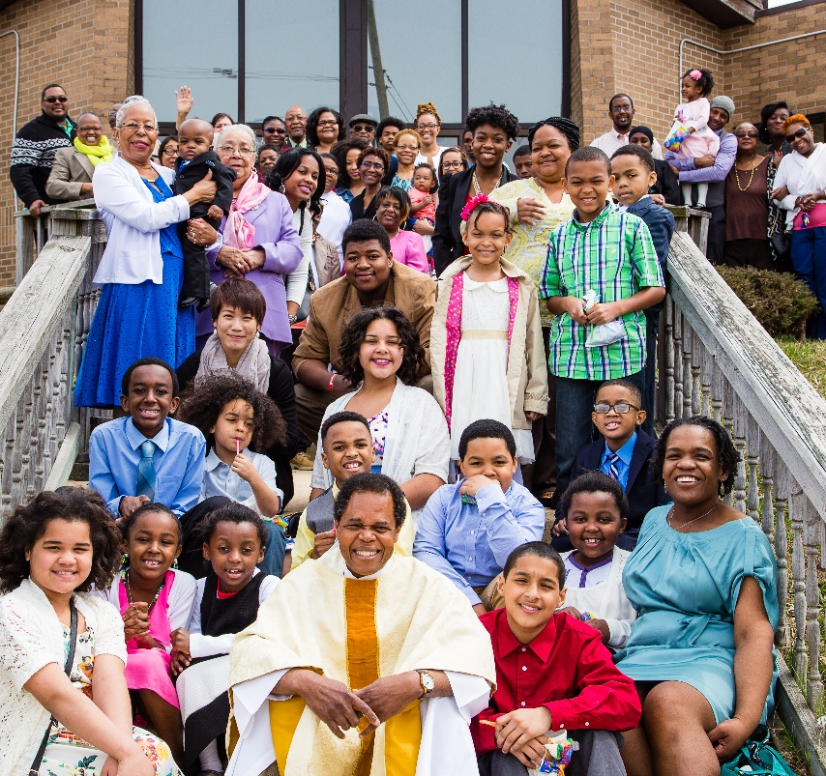
How to Partner with IPC
3. IPC as an Advisor
Behind-the-scenes advisor on program development
Help train your staff on religious/cultural sensitivity
4. IPC as Pipeline Builder
Help us reach more people – exposure, e-shares
Capacity-building so we can draw in more audiences

Slide 11
Questions and More Information
www.interfaithchesapeake.org
Click “Join” in upper right-hand corner to sign up for email list

