Slide 1
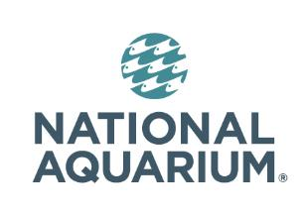
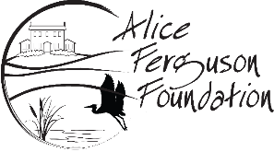
Healthy Watershed Initiatives for Diverse Communities
Curtis Bennett, Director of Conservation Community Engagement, National Aquarium
Laura Cattell Noll, Assistant Program Manager
Alice Ferguson Foundation

Slide 2
How to Approach Community Engagement?
Who We Are? What We Do? Why Have We Prioritized Community Engagement?
Get to Know Your Community & Community Needs (Community Members as Experts)
Identifying & Developing Partnerships with Community Pillars
Mutually Beneficial Goals & Collaborative Programs
Maintaining & Expanding Partnerships (Project Sustainability & Capacity Building)

Slide 3
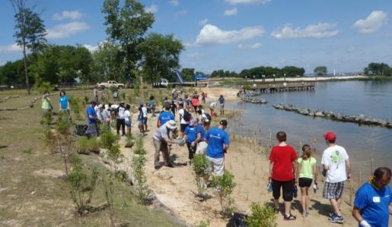
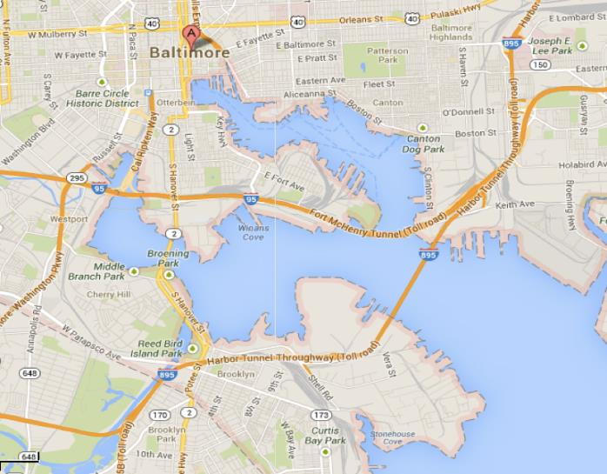
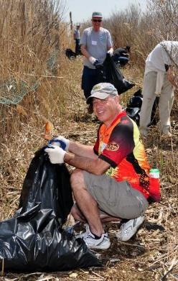
National Aquarium: Urban Conservation
Notes:
Mission of the National Aquarium: Inspire Conservation of the World’s Aquatic Treasures
Urban conservation in the Aquarium’s backyard within the city of Baltimore
Inner Harbor
Fort McHenry
Middle Branch
Farring Baybrook Park
Masonville Cove

Slide 4
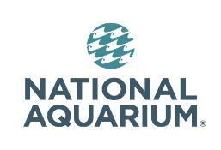
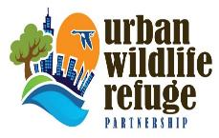
South Baltimore Community Engagment and Environmental Stewardship Project
Notes:
Designated in 2013.
This is a restored green space in South Baltimore that has an environmental education facility and areas where the public can enjoy the restored natural habitat. The Cove used to be a beach site
So much of what we did at the time was focused on bringing groups out to Masonville, but we felt like there was a need to go beyond that and involve the community in the site and make connections to the watershed. Engage the community to connect them to Masonville cove and the watershed.
MPA reaching out to surrounding communities

Slide 5
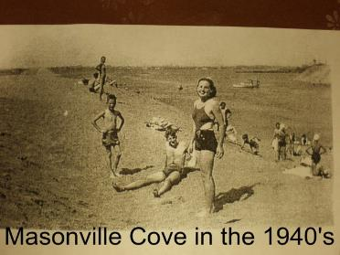
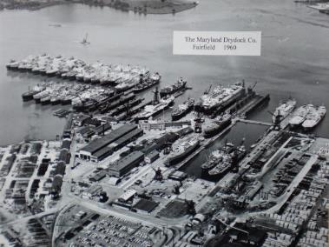
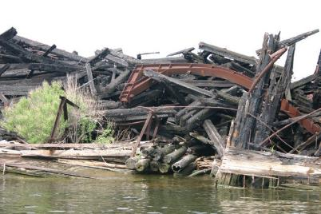
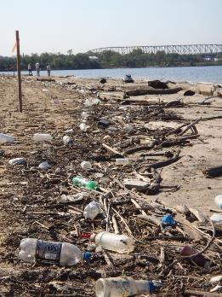
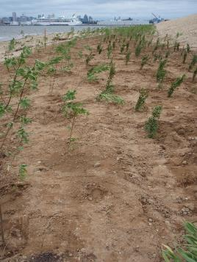
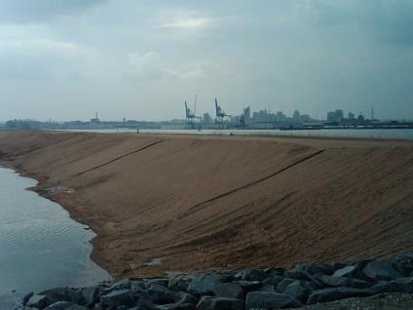
Notes:
Masonville Cove is a restored site in South Baltimore. In the 1940s it was a community beach site, but over time as industry came into the area it became a dumping ground where ships were taken apart and put back together.
The Maryland Port Administration was building a DMCF at the Cove and needed to do remediation. They went to the community and asked what they would like to see, and they asked for access back to the water where the community would have an opportunity to learn about the environment.
60,000 tons of debris was removed from the site and restoration began

Slide 6
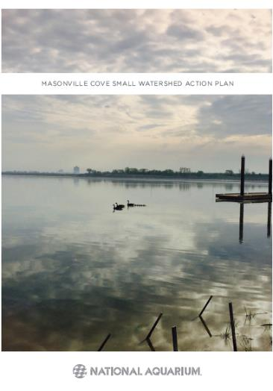
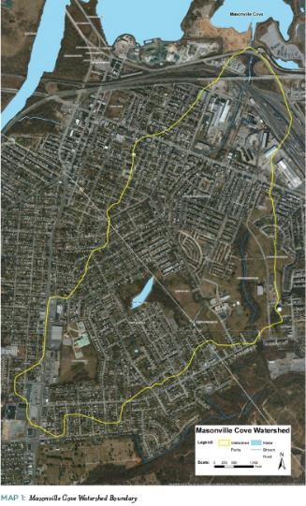
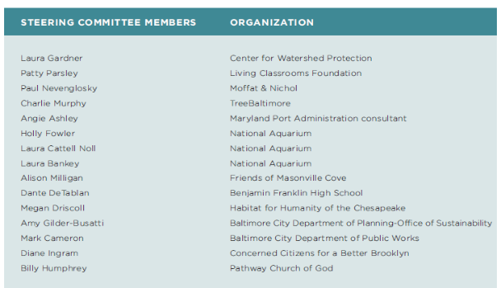
Masonville Cove Small Watershed Action Plan
Notes:
One of our biggest successes was at the on start of this project where we were able to identify key trusted leaders and interest, establish forums and begin dialogue, understand how community issues link to watershed restoration, assess needs and preferences for ongoing communications
One of the key actions was to identify interests in underrepresented communities.
Establish forums and begin dialogues to better understand how community issues link to watershed restoration
The process of developing a Small Watershed Action plan was a way to involve community members in the assessment of their watershed and connect them to the cove. SWAPS are designed to identify solutions for getting watersheds back into compliance with state standards.
National Aquarium came together with the Center for Watershed Protection to create a SWAP for the watershed. As a way to keep community stakeholders involved in the restoration, we met with community stakeholders to identify and map out hotspot areas in the community areas of flooded streets, rat infestation, illegal dumping, etc. Allow them to address issues in their watershed and come up with solutions to address them.
FINAL PRIMARY RECOMMENDATIONS:
Implement a Bioretention Projects
Implement a Regenerative Stormwater Conveyance Projects
Develop a comprehensive education/outreach/stewardship plan around reducing litter in the two affected communities of Brooklyn and Curtis Bay
SECONDARY RECOMMENDATIONS:
Increase the tree canopy within the watershed
Promote environmental stewardship
Promote environmentally friendly development

Slide 7
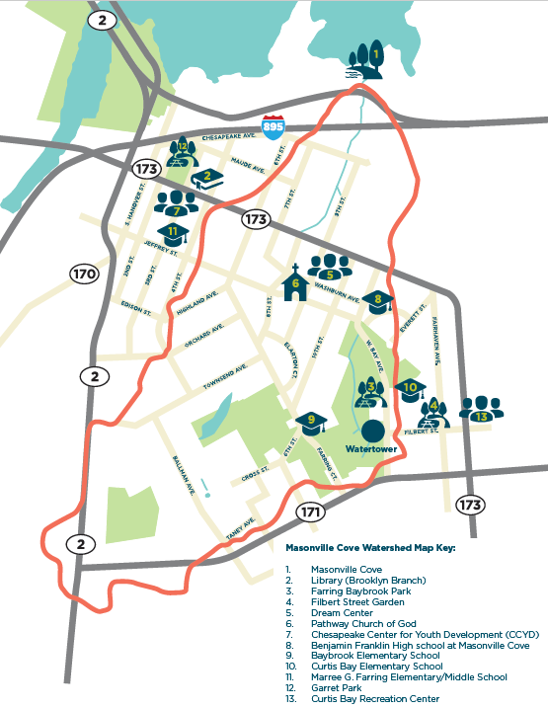
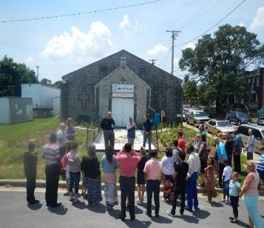
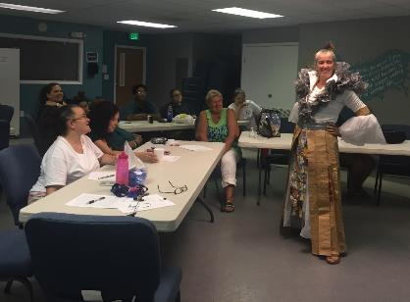
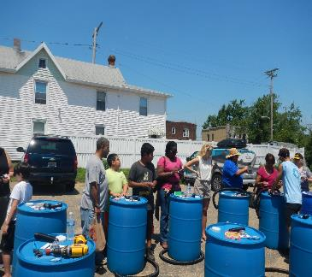
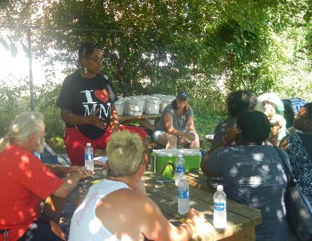
Community Pillars
Notes:
identify key trusted leaders and interest, establish forums and begin dialogue, understand how community issues link to watershed restoration, assess needs and preferences for ongoing communications
One of the key actions was to identify interests in underrepresented communities.
Establish forums and begin dialogues to better understand how community issues link to watershed restoration
Identifying key trusted community leaders, those pillars and reaching diverse audiences: 2,800 people from Curtis Bay and Brooklyn have been engaged since October. Community greening and cleaning. Bringing together diverse audiences in South Baltimore. English and Hispanic congregations working together with neighbors, community volunteers, habitat homeowners, etc.
Community associations
Local high school (ESL program)
Churches- English and Hispanic congregation
Women's Mentoring organizations
BCPD youth camps
Summer youth works
Non profits- CCYD, Filbert Street Garden
Hispanic Access Foundation
Habitat from Humanity homeowners
Importance of partnering with other groups and orgs
Storm Drain Stenciling
Community Cleanups in Brooklyn, Curtis Bay
Masonville Cove Cleanups
Native Habitat Gardening Workshop
25 Residential Native Habitat Garden Plantings
Watershed 101 Workshop
Masonville Cove Field Trips: nature walks and trash cleanups
Wetland Plantings at Masonville Cove
Bioblitz and Open House at Masonville Cove
Citizen Science Monitoring at Masonville Cove
Pollinator Workshop
Rain Barrel Workshops
Composting Workshops
Masonville Cove Impact Day
Community Events (Curtis Bay Cookout, Benfest, Fun Fest at the Well)
Read to Reef (Spring/Summer Reading Program)
Community Action Plan: Green Infrastructure and Community Resilience in Brooklyn, Baltimore
Rain Garden Installation at Ben Franklin High School
**Surveys are being implemented to gage from community members what their thoughts and feelings are about their community and what they think the most effective solutions might be- these are community facilitated surveys
Being all inclusive in programming- translating storm drain stencils into Spanish. Going to community run events to run activities. Neighbors connecting with neighbors- bringing them along to participate in programming. Neighbors helping neighbors and creating a sense of community.
5. Increase collaboration with environmental justice entities throughout the Bay Watershed and incorporate their perspectives and those of community and faith‐based organizations and leaders throughout the Bay Program governance structure, including its three advisory committees (citizens, local governments and scientific/technical).

Slide 8
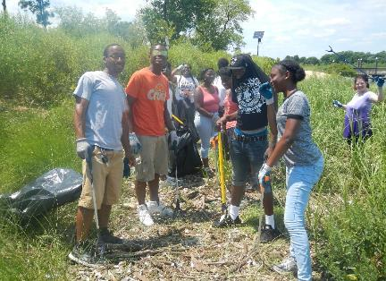
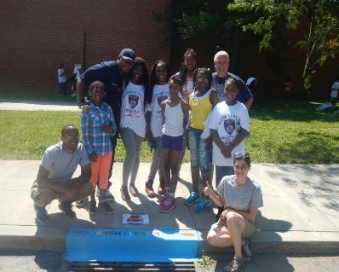
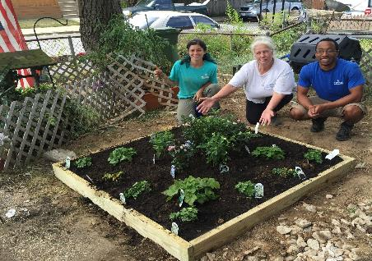
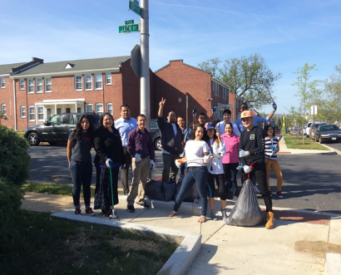
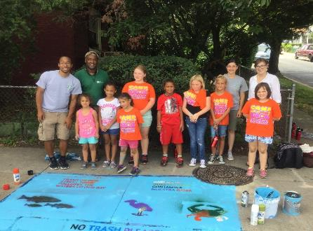
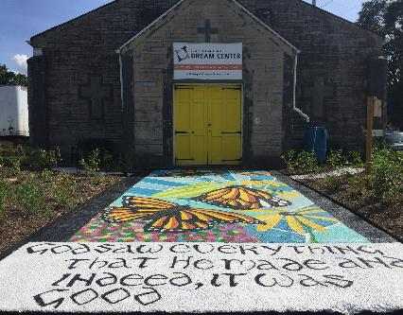
Collaborative Programs & Projects
Notes:
Engaging youth in community action

Slide 9
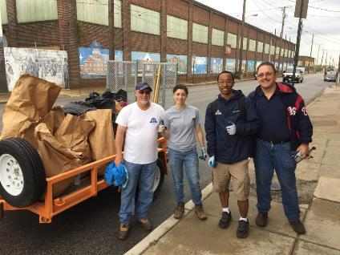
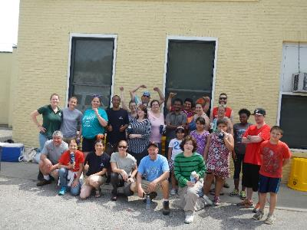
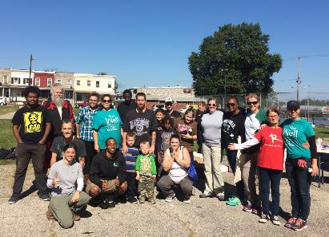
Community Capacity Building
October 2016
October 2015
April 2017

Slide 10
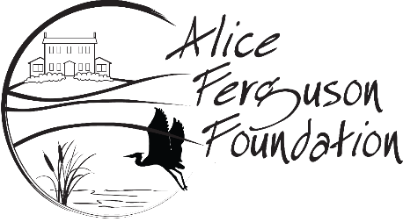
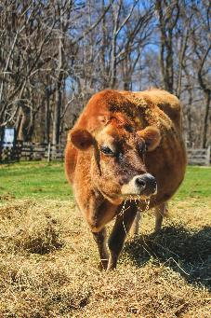
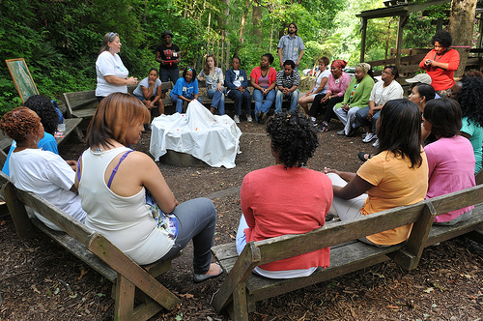
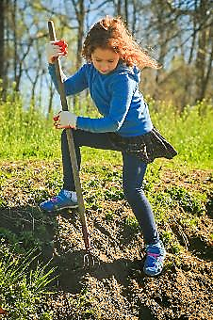
MISSION: To connect people to the natural world, sustainable agricultural practices and the cultural heritage of their local watershed through education, stewardship and advocacy
Notes:
Who we are
What we do
Why we have prioritized community engagement

Slide 11
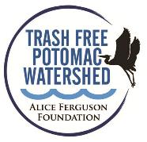
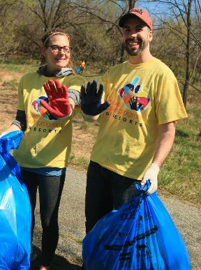
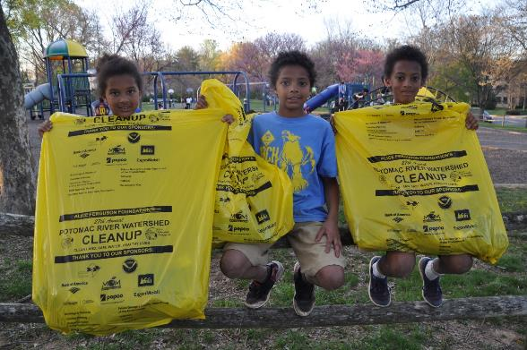
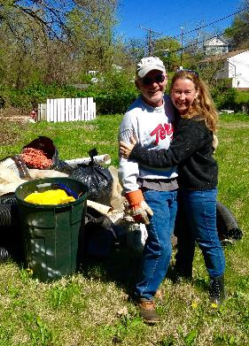
Trash Free Potomac Watershed

Slide 12
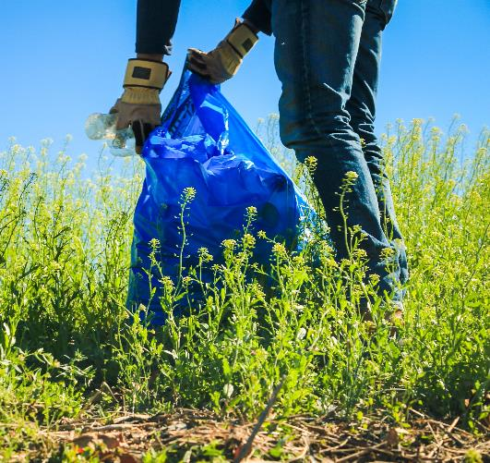
Focus Groups
“For me, health is a really important thing…I think it’s more important than anything to have good, clean, healthy water.” –
Focus Group Participant

Slide 13
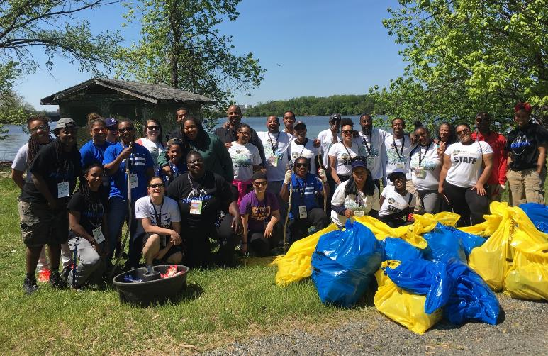
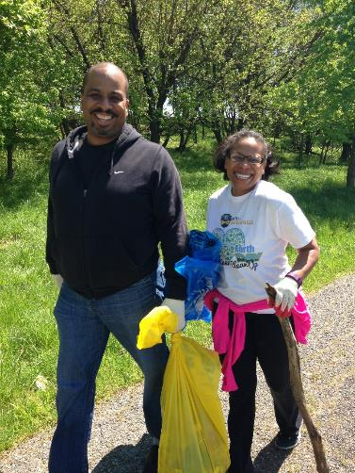
Developing Partnerships

Slide 14
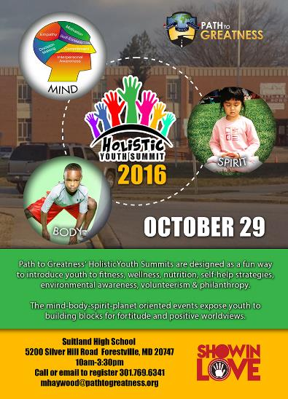
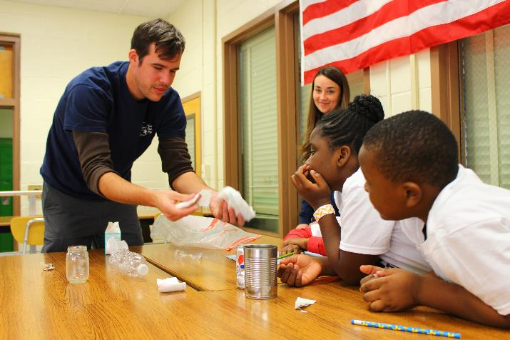
Collaborative Programs

Slide 15
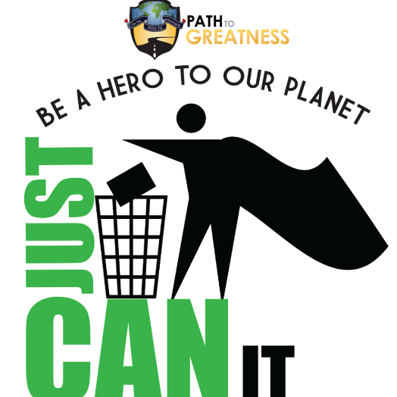
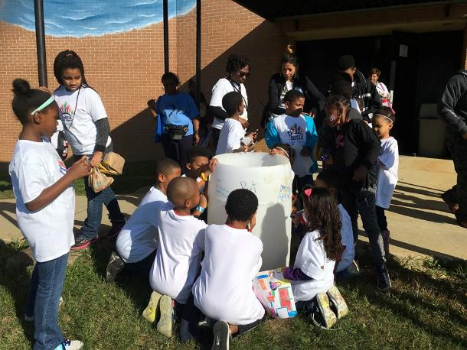
Expanding Partnerships

